Slide 1
Using XML Mapper and Enterprise Guide to Read Data and Metadata from an XML File
Larry Hoyle, Inst. For Policy & Social Research
University of Kansas
Paper 030-2010
SAS Global Forum 2010

Slide 2
General Issue
Read an XML file containing both
  Data
  Metadata
Convert those data into something usable in SAS

Slide 3
Specific Goal:
Stata “dta” XML file To SAS Dataset
Data
SAS compatible metadata (Labels, formats)
Other metadata

Slide 4
XML for Data – Two Approaches
“Ad Hoc”
  Element names are metadata
Fixed Structure
  Predefined element names
  All data and metadata in content, not structure

Slide 5
“Ad Hoc”
Example – Default SAS® Libname Engine XML
<?xml version="1.0" encoding="windows-1252" ?>
<TABLE>
<MYSAS1>
<n>1</n>
<charvar>one</charvar>
<created>1579430009.854</created>
</MYSAS1>
<MYSAS1>
<n>2</n>
<charvar>two</charvar>
<created>1579430009.854</created>
</MYSAS1>
</TABLE>
Table Name
Column Names

Slide 6
“Ad Hoc”
Advantages
  Human readable
  Relatively Compact
  Simple
Disadvantages
  Every table has a different set of element names
  Where do metadata go?

Slide 7
Fixed Element and Attribute Names
Example SAS “xmltype=export”
  Structure has fixed element names
  Variable names as values of attributes
<DATA> defines a row
<TABLE-DATA>
<DATA>
<DATUM-NUMERIC name="n">10</DATUM-NUMERIC>
<DATUM name="charvar">ten</DATUM>
<DATUM-NUMERIC name="created">
1579430010.197
</DATUM-NUMERIC>
</DATA>
<DATA>
<DATUM-NUMERIC name="n">11</DATUM-NUMERIC>
<DATUM name="charvar">eleven</DATUM>
<DATUM-NUMERIC name="created">1579430010.197</DATUM-NUMERIC>
</DATA>
</TABLE-DATA>

Slide 8
Fixed Element and Attribute Names
Example SAS “xmltype=export”
  Structure has fixed element names
  Variable names as values of attributes
<DATAUM-NUMERIC> defines a column
<TABLE-DATA>
<DATA>
<DATUM-NUMERIC name="n">10</DATUM-NUMERIC>
<DATUM name="charvar">ten</DATUM>
<DATUM-NUMERIC name="created">
1579430010.197
</DATUM-NUMERIC>
</DATA>
<DATA>
<DATUM-NUMERIC name="n">11</DATUM-NUMERIC>
<DATUM name="charvar">eleven</DATUM>
<DATUM-NUMERIC name="created">1579430010.197</DATUM-NUMERIC>
</DATA>
</TABLE-DATA>

Slide 9
Fixed Element and Attribute Names
A place for metadata
<TABLE name="mySAS2">
<TABLE-HEADER>
<Provider>SAS Institute Inc.</Provider>
…
<TABLE-METADATA>
…
<COLUMN order="3" name="created">
<TYPE>numeric</TYPE>
<DATATYPE>float</DATATYPE>
<FORMAT>B8601DT</FORMAT>
</TABLE-METADATA>

Slide 10
Fixed Element and Attribute Names
Disadvantage
  Can be more verbose
  Less human readable
Advantage
  More machine actionable
  Structured metadata with the data
  In our case – we can make a SAS XML Map

Slide 11
Hierarchy, One to Many
One value_labels
<value_labels>
<vallab name='SeasonFR'>
<label value='1'>Hiver</label>
<label value='2'>Printemps</label>
<label value='3'>Ete</label>
<label value='4'>Automne</label>
</vallab>
<vallab name='Season'>
<label value='1'>Winter</label>
<label value='2'>Spring</label>
<label value='3'>Summer</label>
<label value='4'>Fall</label>
</vallab>
<vallab name='OnJansen'>
<label value='0'>None</label>
<label value='1'>Partial</label>
<label value='2'>Complete</label>
</vallab>
</value_labels>
Many vallab
(variable number)

Slide 12
XMLMap – Hierarchy, One to Many
For each vallab
<value_labels>
<vallab name='SeasonFR'>
<label value='1'>Hiver</label>
<label value='2'>Printemps</label>
<label value='3'>Ete</label>
<label value='4'>Automne</label>
</vallab>
<vallab name='Season'>
<label value='1'>Winter</label>
<label value='2'>Spring</label>
<label value='3'>Summer</label>
<label value='4'>Fall</label>
</vallab>
<vallab name='OnJansen'>
<label value='0'>None</label>
<label value='1'>Partial</label>
<label value='2'>Complete</label>
</vallab>
</value_labels>
Many label elements
(variable number)

Slide 13

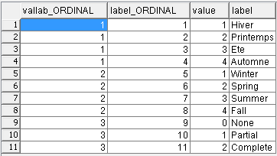
XMLMap – Hierarchy to Relational Tables
vallab table
<value_labels>
<vallab name='SeasonFR'>
<label value='1'>Hiver</label>
<label value='2'>Printemps</label>
<label value='3'>Ete</label>
<label value='4'>Automne</label>
</vallab>
<vallab name='Season'>
<label value='1'>Winter</label>
<label value='2'>Spring</label>
<label value='3'>Summer</label>
<label value='4'>Fall</label>
</vallab>
<vallab name='OnJansen'>
<label value='0'>None</label>
<label value='1'>Partial</label>
<label value='2'>Complete</label>
</vallab>
</value_labels>
label table

Slide 14
XMLMap File – From Hierarchy to Tables
FROM
TO
<value_labels>
<vallab name='SeasonFR'>
…
XMLMap
<TABLE name="vallab">
<TABLE-DESCRIPTION>vallab</TABLE-DESCRIPTION>
<TABLE-PATH syntax="XPath">/dta/value_labels/vallab</TABLE-PATH>
…
<COLUMN name="name">
<PATH syntax="XPath">/dta/value_labels/vallab/@name</PATH>
<TYPE>character</TYPE>
<DATATYPE>string</DATATYPE>
<LENGTH>8</LENGTH>
</COLUMN>
</TABLE>

Slide 15
XMLMap File – Rows
FROM
TO
<value_labels>
<vallab name='SeasonFR'>
…
What Element Denotes ROWS
XMLMap
<TABLE name="vallab">
<TABLE-DESCRIPTION>vallab</TABLE-DESCRIPTION>
<TABLE-PATH syntax="XPath">/dta/value_labels/vallab</TABLE-PATH>
Described by an “XPATH”

Slide 16
XMLMap File – Columns
FROM
TO
<value_labels>
<vallab name='SeasonFR'>
…
Which Elements/Attributes Denote Columns
XMLMap
<COLUMN name="name">
<PATH syntax="XPath">/dta/value_labels/vallab/@name</PATH>
<TYPE>character</TYPE>
<DATATYPE>string</DATATYPE>
<LENGTH>8</LENGTH>
</COLUMN>
Also described by an XPATH

Slide 17
XMLMap File – Rows Numbered
FROM
TO
<value_labels>
<vallab name='SeasonFR'>
…
Ordinals can be generated to uniquely identify rows

Slide 18
XMLMap File – Retained Information
FROM
TO
<value_labels>
<vallab name='SeasonFR'>
…
Data higher in the hierarchy can be retained as the XML is parsed

Slide 19
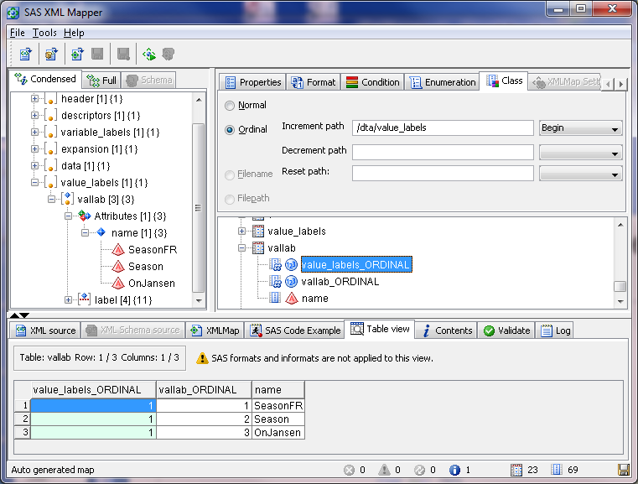
XML Mapper – GUI for Making XMLMap Files

Slide 20
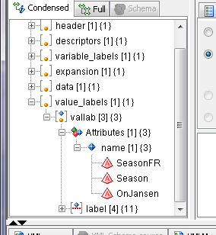
XML Mapper – Drag and Drop From Structure

Slide 21
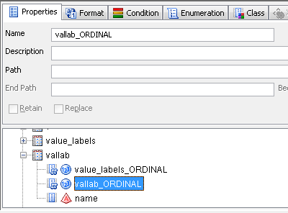
Table Definition (Column vallab_ORDINAL)
Row element
defines table

Slide 22
Table Definition (Column vallab_ORDINAL)
Column elements
within tables

Slide 23
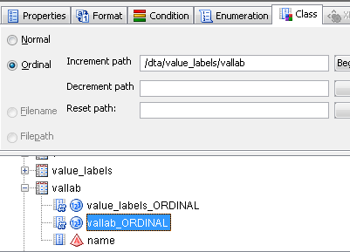
Ordinals
Element on which to increment

Slide 24
What if Order Matters?
<data>
<o>
<v>SUGI &apos;76</v>
<v></v>
<v>Hyatt World</v>
<v>Kissimmee</v>
</o>
<o>
<v>SUGI &apos;77</v>
<v></v>
<v>Fairmont</v>
Third <V> within an <o> is column 3

Slide 25
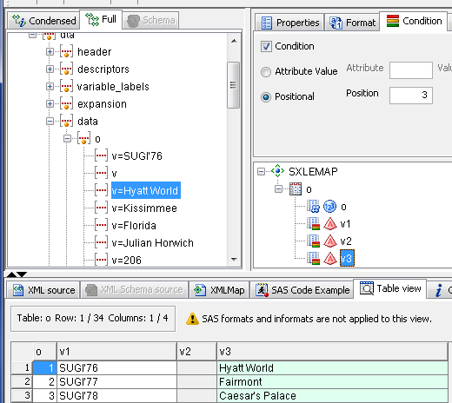
Positional – using the order of elements
Third <V> within an <o> is column 3

Slide 26
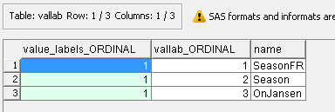
XML Mapper – Table Preview

Slide 27
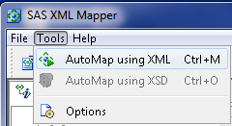
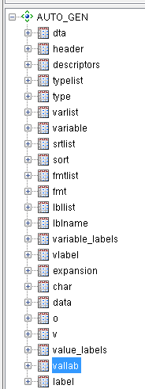
Handy Feature - Automap
For Our File:
One Click Makes All These Tables

Slide 28
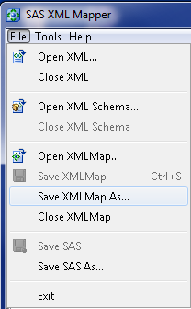
Save XMLMap File and SAS Code
/*************************
* Generated by XML Mapper,
*************************/
/* * Environment */
filename SUGISGF3 'C:\SUGI_SGF3.xml';
filename SXLEMAP 'C:\SGF_030_2010_XMLmap.map';
libname SUGISGF3 xml xmlmap=SXLEMAP
access=READONLY;
/* * Catalog */
proc datasets lib=SUGISGF3; run;
/* * Contents */
proc contents data=SUGISGF3.dta varnum; run;

Slide 29
SAS Code
This XML
/*************************
* Generated by XML Mapper,
*************************/
/* * Environment */
filename SUGISGF3 'C:\SUGI_SGF3.xml';
filename SXLEMAP 'C:\SGF_030_2010_XMLmap.map';
libname SUGISGF3 xml xmlmap=SXLEMAP
access=READONLY;
/* * Catalog */
proc datasets lib=SUGISGF3; run;
/* * Contents */
proc contents data=SUGISGF3.dta varnum; run;
Mapped by this XMLMap file

Slide 30
Hands-On Workshop This Afternoon
Paper 157-2010 Lex Jansen
Understanding the define.xml File and Converting It to a Relational Database
Tuesday 3:30 PM

Slide 31
XML Mapper Issues with “Real World” XML
Prototype not fully representative
“Invalid” XML
  XML does not match DTD or schema
  Lower validation level in XML Mapper?
SAS libname engine does not process DTDs
  Ignore?
“WARNING: DOCTYPE element encountered. The SAS XML Libname Engine does not support processing of Data Type Definitions (DTD). External entity references in the document will not be resolved, and no mark up validation will be performed.”

Slide 32
Everything is in Tables: All Done?
Not Yet

Slide 33
From 23 tables to 3 tables
XML Map generates 23 tables
We need 3
  Dataset
  CNTLIN dataset
  Other metadata dataset
Content / Role | Table(s)
Data - columns | v
Data - rows | o
List of variables | variable
Variable labels | vlabel
Data type and length | fmt, type
Dataset information - label, timestamp, nobs etc | header, char
Sort order | sort
Value labels (formats) | vallab, label
Link formats to variables | lblname
Other variable characteristics | char

Slide 34
Stata “dta” XML file TO SAS Dataset
Tasks
Data
  Transpose from one number per row to one row per observation
  Name columns
  Convert from text to proper type (e.g. numeric, dates)
Assign dataset, and variable labels
(value) “labels” to SAS formats or “formats” to formats
Capture other metadata
  Notes
  Characteristics

Slide 35
Build a Repeatable Process
Create a process that converts ANY XML file of this type
Simple to use
Documented

Slide 36
Document
Sequence of steps
Which tables are used for what
Enterprise Guide? (EG)

Slide 37
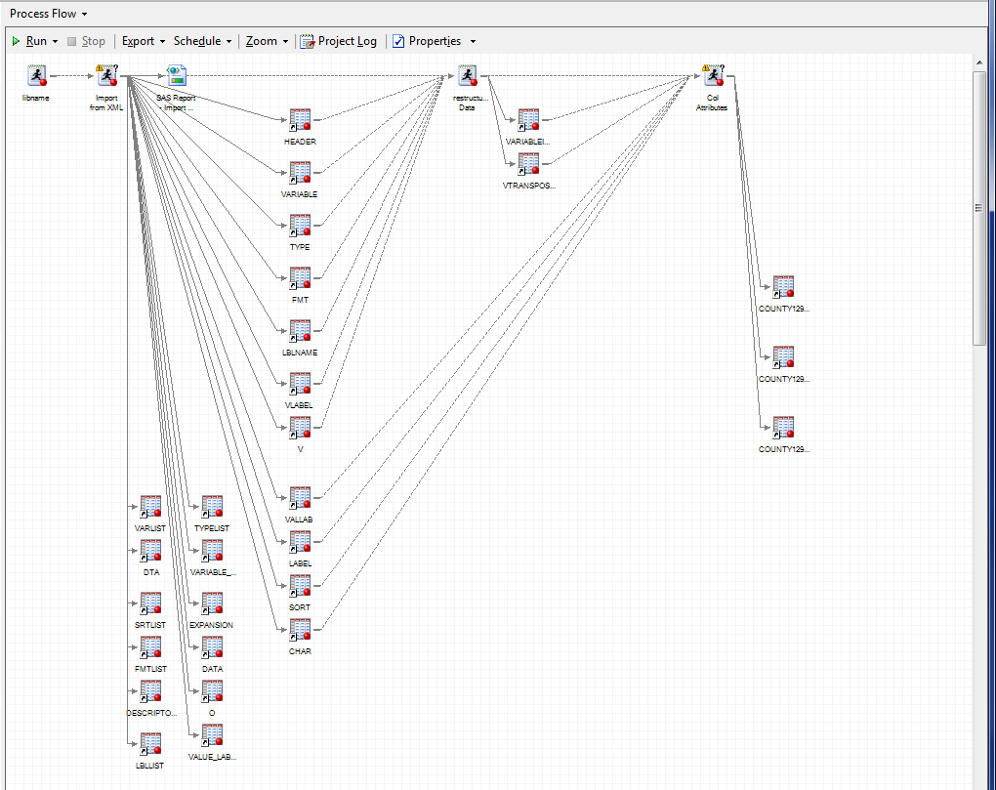
EG Process Flow Diagram
XML Mapper Code
Code sequence
Creates these tables
These Tables
are inputs to this code

Slide 38
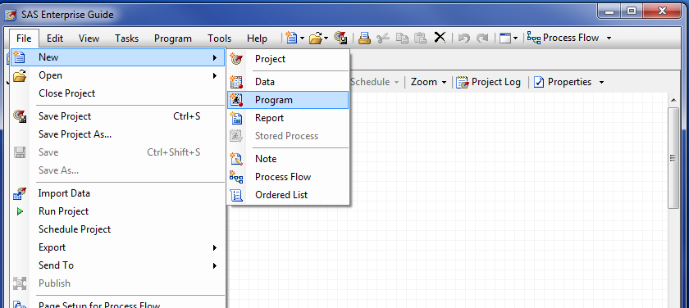
Enterprise Guide Project
SAS Code from XML Mapper
We could link to external code but
  Copying puts it in the project
  We’ll modify the code

Slide 39
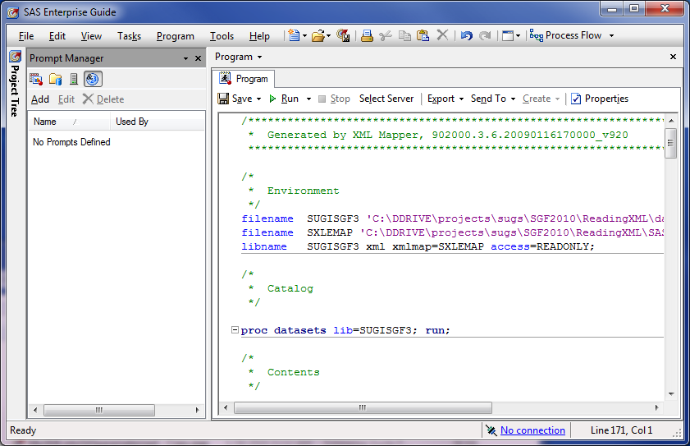
Paste the Code from XML Mapper

Slide 40
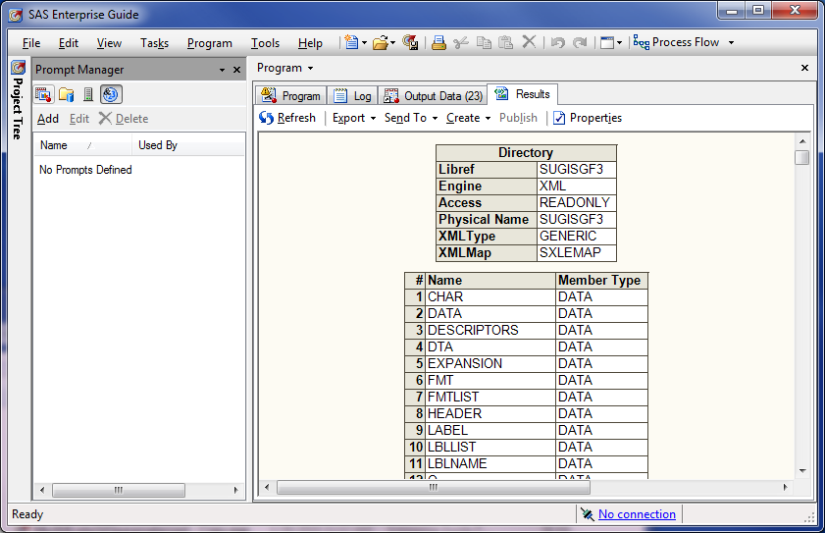
Run the Code

Slide 41
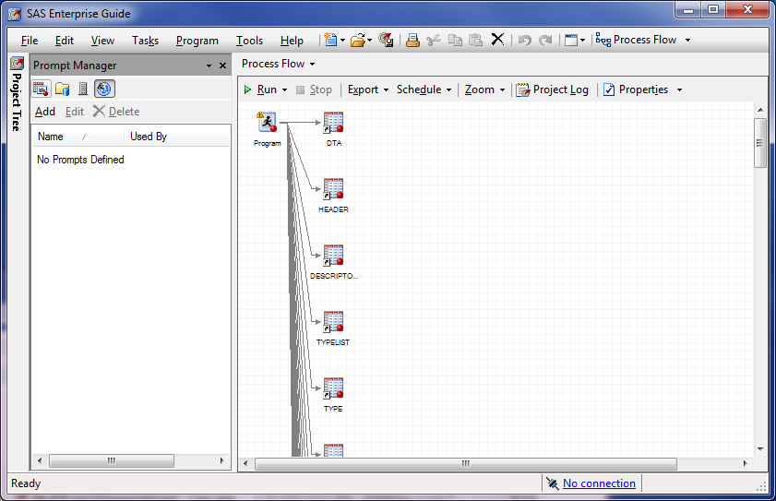
Process Flow

Slide 42
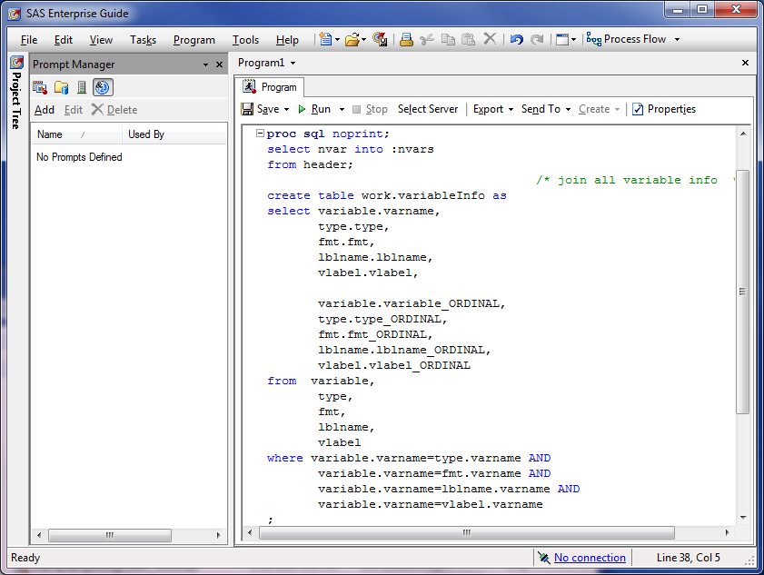
New Program Node – Aggregate Variable Info

Slide 43
Code We Write
create table work.variableInfo as
select variable.varname, type.type,
fmt.fmt, lblname.lblname,
vlabel.vlabel, variable.variable_ORDINAL,
type.type_ORDINAL, fmt.fmt_ORDINAL,
lblname.lblname_ORDINAL, vlabel.vlabel_ORDINAL
from variable,
type,
fmt,
lblname,
vlabel
where variable.varname=type.varname AND
variable.varname=fmt.varname AND
variable.varname=lblname.varname AND
variable.varname=vlabel.varname;
Five tables have metadata about variables

Slide 44
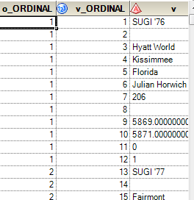
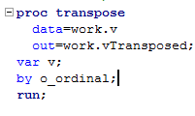

Table V Has Tall Skinny Data - Transpose
V
VTransposed

Slide 45
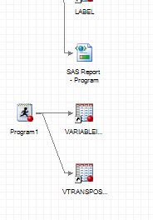
We’re Building a Process
Best to:
  Give nodes useful names
  Link steps and datasets

Slide 46
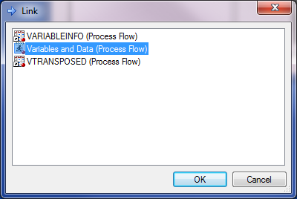
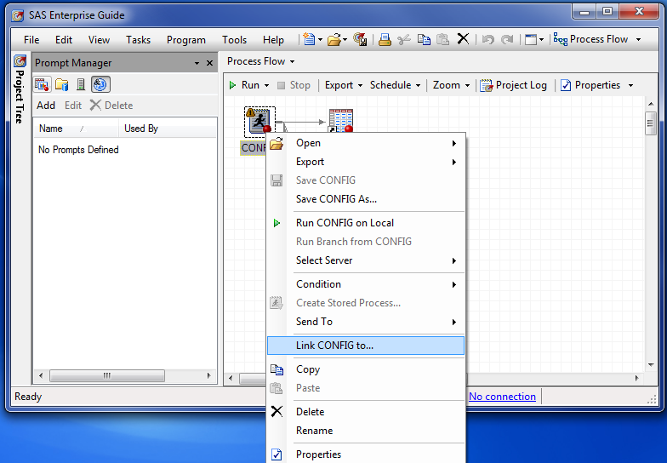
Linking the Program Nodes
Variables and Data
Link CONFIG to…

Slide 47
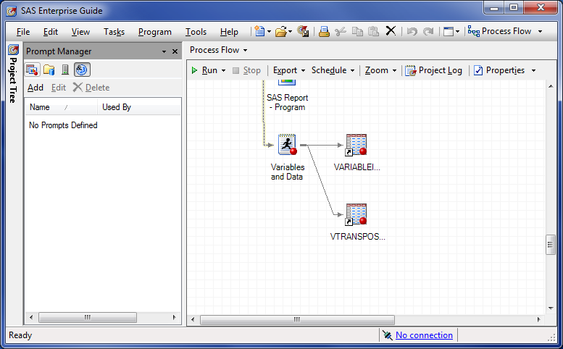
Linked
Link

Slide 48
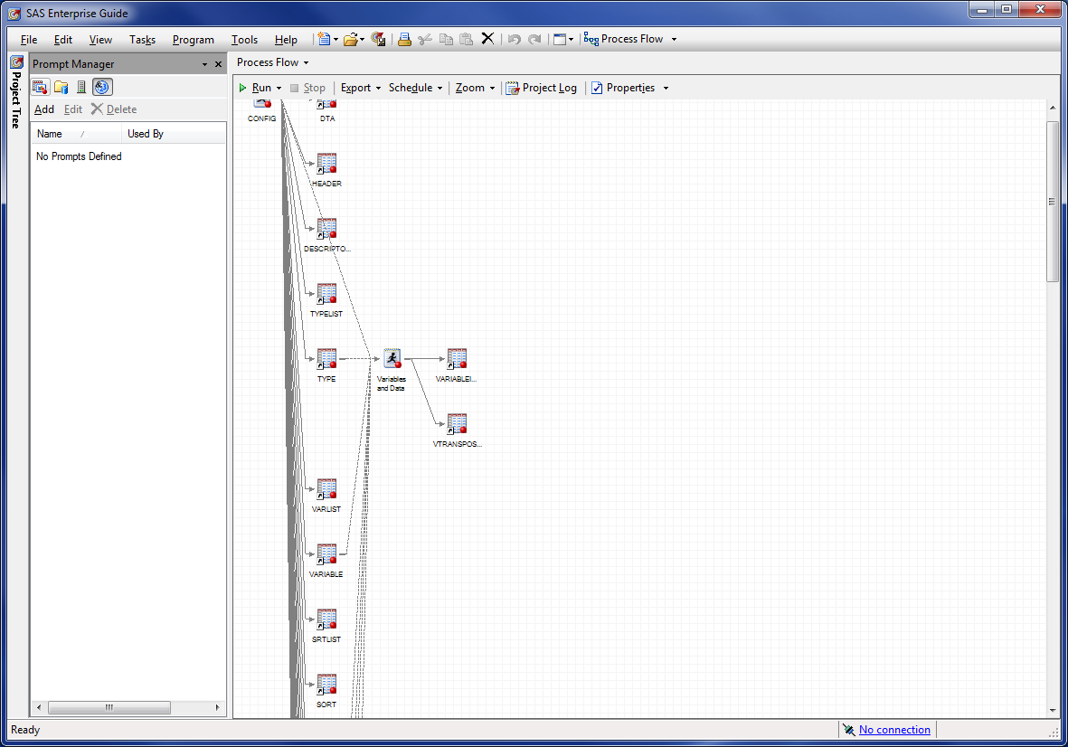
Also Link Contributing Datasets
Arrangement is kind of a mess

Slide 49
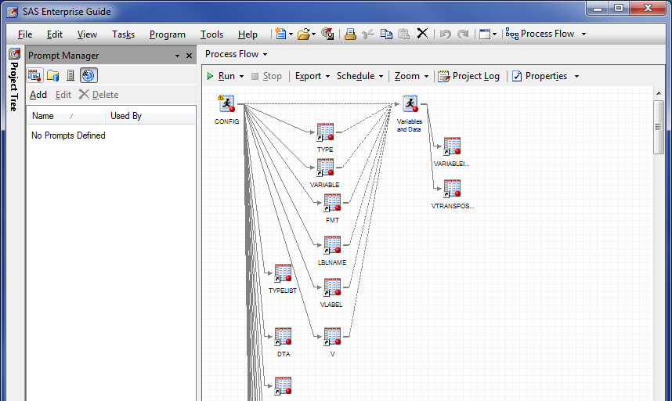
Option – Turn Off AutoArrange – Layout Manually

Slide 50
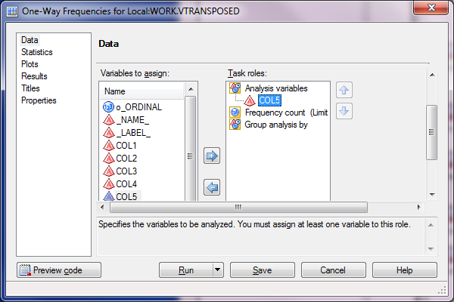
Task Wizards Are Available

Slide 51
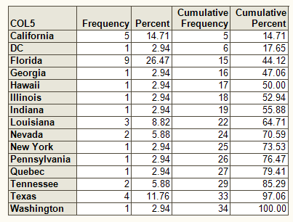
SUGI/SGF States

Slide 52
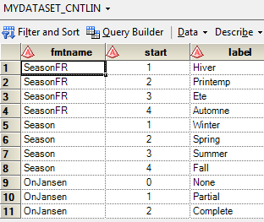
CNTLIN Facility
Create Formats from a File
Proc format;
Value Season
1 = "Winter"
2 = "Spring"
3 = "Summer"
4 = "Fall" ;
Value OnJansen
0 = "None"
1 = "Parital"
2 = "Complete" ;

Slide 53
Translating to SAS Formats
From To
  %21s $21.
  %8.0g Best8.
  %td Date.

Slide 54
Identify with Perl Regular Expressions
From PRX
  %21s '/^%[-~]*(\d+)s/'
  %8.0g '/^%-*(\d+)\.(\d+)g/'
  %td '/^%td/'

Slide 55
Match the Type of Format
From PRX
  %8.0g '/^%-*(\d+)\.(\d+)g/‘
Type of format

Slide 56
Split Out Pieces – One or More Digit
Before the Decimal Point
From PRX
  %8.0g '/^%-*(\d+)\.(\d+)g/‘
Preceding Decimal Point
String matched within parentheses “captured”

Slide 57
Split Out Pieces – One or More Digit
After the Decimal Point
From PRX
  %8.0g '/^%-*(\d+)\.(\d+)g/‘
Following Decimal Point
String matched within parentheses “captured”

Slide 58
An array of possibilities
30 Possible Patterns
array fmts {&nPatterns,3} $ 30 _temporary_ (
'/^%-*(\d+)\.(\d+)g/' 'BEST' '2’
'/^%-*(\d+)\.(\d+)f/' ' ' '2’
'/^%-*(\d+)\.(\d+)e/' 'E', '2’
'/^%(\d+)x/' 'HEX' '2’
Base of SAS Format
Number of Numeric Pieces

Slide 59
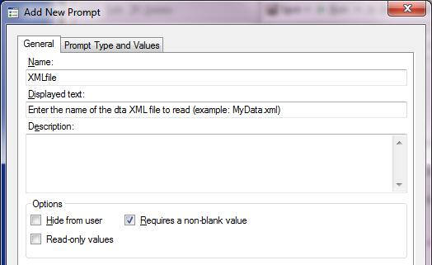
Parameterizing the Process with Prompts
Create the Prompt

Slide 60

Parameterizing the Process with Prompts
Create the Prompt

Slide 61
Parameterizing the Process with Prompts
Create the Prompt
Macro Variable
Displayed when the user is prompted

Slide 62
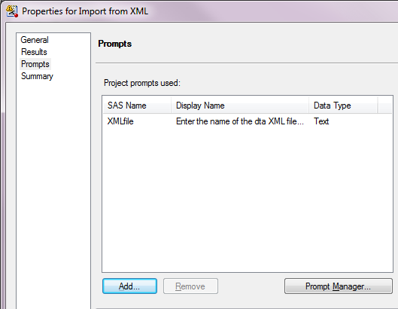
Parameterizing the Process with Prompts
Associate it with a Code Node
Properties of a node
Prompt for the node

Slide 63
Parameterizing the Process with Prompts
Use the Macro Variable in the Code
%let inFolder = C:\ ReadingXML\data\SUGI_SGF_files;
%let mapFolder = C:\ReadingXML\SAScode;
%let mapFile = SGF_030_2010_XMLmap.map;
filename SUGISGF3 "&inFolder.\&XMLfile.";
filename SXLEMAP "&mapFolder.\&mapFile.";
libname SUGISGF3 xml xmlmap=SXLEMAP access=READONLY;
Macro variable reference

Slide 64
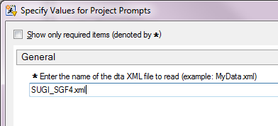
When The Node Runs

Slide 65
Other Metadata
object | object Label | characteristic Type | characteristic
_dta | Dataset: MyDataset | Source | http://support.sas.com/events/sasglobalforum/previous/index.html and http://www.lexjansen.com/sugi/
_dta | Dataset: MyDataset | Origin | http://support.sas.com/events/sasglobalforum/previous/index.html and http://www.lexjansen.com/sugi/
_dta | Dataset: MyDataset | note1 | From 1976 Through 1984 the conferences were named SUGI 'YY where YY was the two digit year. From 1985 through 2006 the conferences were named SUGI nn, where nn was a sequential number beginnig with 10. From 2007 through the present the conferences have been named SGF YYYY, where YYYY is the 4 digit year.
chair | Conference Chair(s) | universe | Heroic, public spirited individuals
city | Conference City | universe | City with adequate facilities for SAS international conference
OnLexJansen | Papers Available on lexjansen.com | note1 | Indicates whether papers are available on Lex Jansen's SUGI paper site: http://www.lexjansen.com/sugi/
season | Season at Beginning of Conference | note1 | can be labeled either by Season or SeasonFR
state | Conference State | universe | U.S. State or Canadian Province or Territory

Slide 66
Other Metadata
“Source” for the whole table (_dta)
object | object Label | characteristic Type | characteristic
_dta | Dataset: MyDataset | Source | http://support.sas.com/events/sasglobalforum/previous/index.html and http://www.lexjansen.com/sugi/

Slide 67
Other Metadata
“universe” for the variable “chair”
object | object Label | characteristic Type | characteristic
chair | Conference Chair(s) | universe | Heroic, public spirited individuals

Slide 68
Complete Code in the Paper
http://www.sascommunity.org/wiki/
Using_XML_Mapper_and_Enterprise_Guide_
to_Read_Data_and_Metadata_from_an_
XML_File

Slide 69
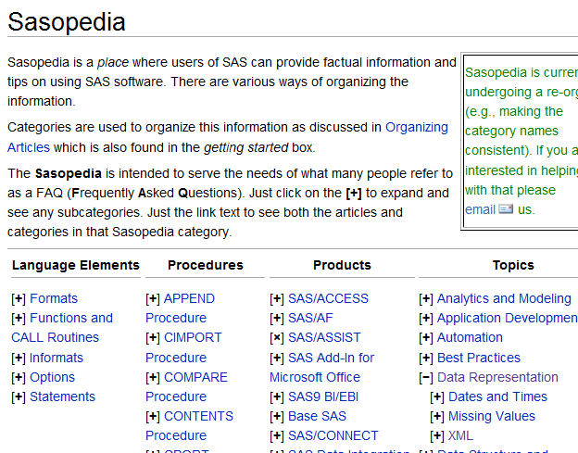
SAScommunity.org
(search for “XML”) or find it in Sasopedia

Slide 70
Contact Information
Larry Hoyle
Institute for Policy & Social Research,
University of Kansas
LarryHoyle@ku.edu
http://www.ipsr.ku.edu/

